Slide 1
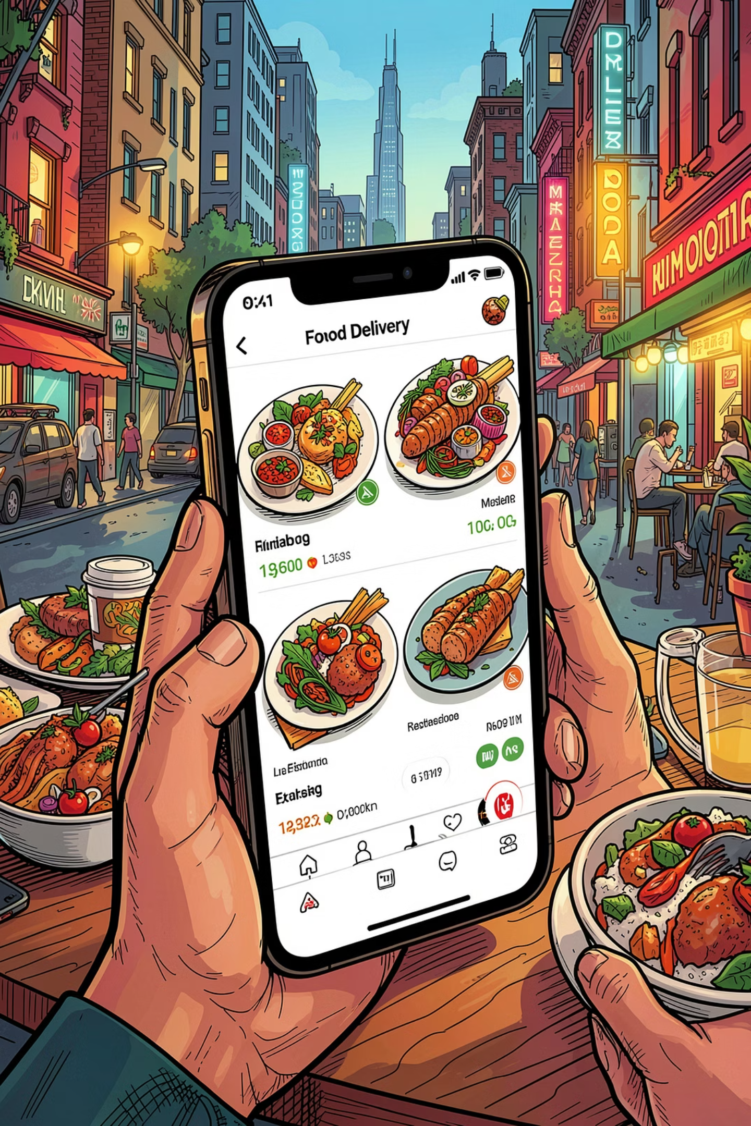
Swiggy Sales Analysis
Using data analytics to optimize restaurant performance, improve customer satisfaction, and support strategic decisions across India's food delivery ecosystem.
KAGGLE DATASET
PYTHON · SQL · POWER BI

Slide 2

Dataset Overview
8,600
Restaurants
Across 9 major Indian cities
9
Cities
Delhi, Mumbai, Bangalore, Chennai, Hyderabad, Pune, Kolkata, Ahmedabad, Surat
8
Columns
State, Area, Price, Rating, Votes, Cuisines, Delivery Time
53.97
Avg Delivery (min)
Average delivery time across all restaurants

Slide 3


Data Preparation in Python
Key Steps
Loading & Exploration: Imported via pandas; used df.info() and .describe() for structure and summary stats
Cleaning: Handled missing data, standardized columns, formatted numerical values for Price and Avg_Ratings
New Columns: Created Price_Category, Delivery_Status, Rating_Status, Popularity_Score, and Popularity_Status

Slide 4
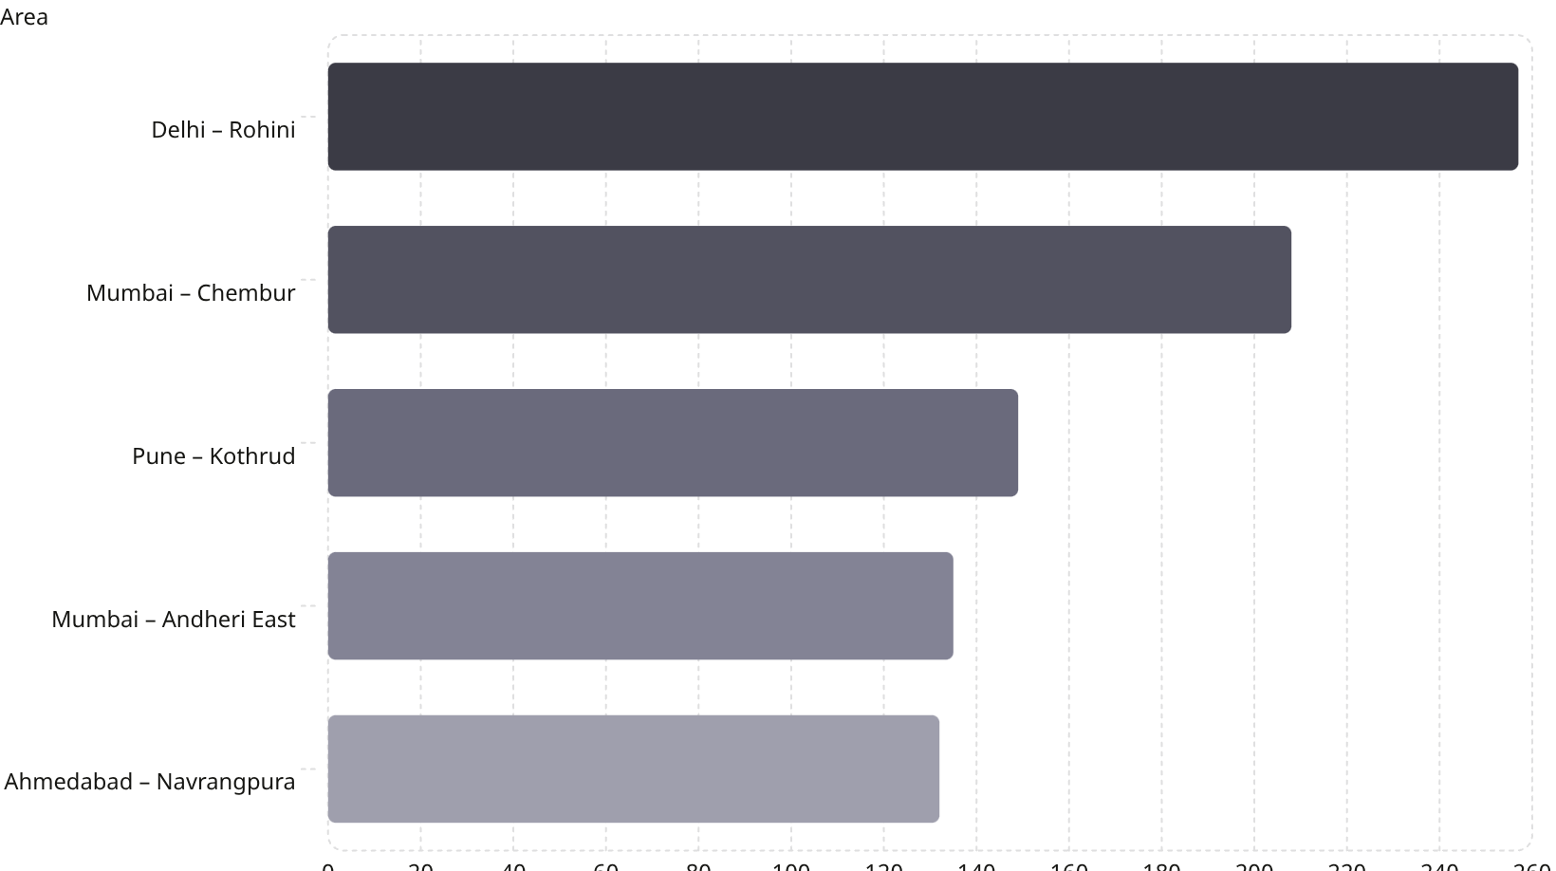
SQL Analysis: Restaurant Distribution
Key Findings
843 areas analyzed across all 9 cities
Rohini (Delhi) leads with 257 restaurants — highest density
Top 5 areas account for significant market concentration
199 areas have restaurants with high ratings AND high popularity scores

Slide 5
SQL Analysis: Ratings & Popularity
🏆 Top 10 Popular Restaurants
⭐ Rating Status by City
📍 Best-Rated Areas
Chennai has the most high-rated restaurants (552). Bangalore: 474 high, 311 low, 161 avg-rated. Ahmedabad: 304 low-rated, 263 high-rated.
Ashok Nagar (Bangalore) leads with avg rating of 4.7 across 6 restaurants. Alwarpet (Chennai) and Koregaon Park (Pune) both at 4.6.
Guru Kripa (Mumbai) leads with a popularity score of 38.33, followed by Grand Hotel and 4M Biryani House (Hyderabad) at 37.76.

Slide 6
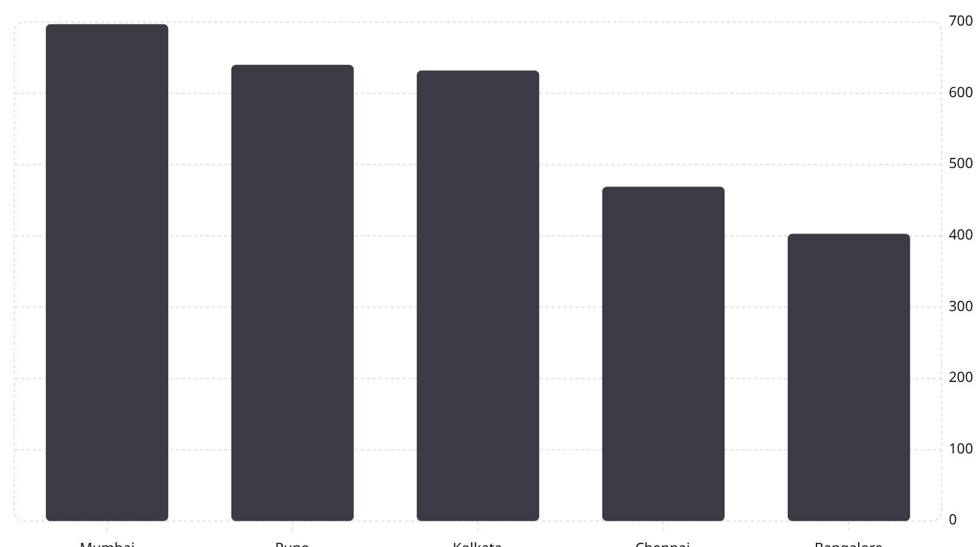
SQL Analysis: Risk & Opportunity
Critical Insights
2,625 costly restaurants have low popularity scores — prime candidates for discounts or meal combos
386 areas have restaurants with bad delivery times; Ahmedabad's Vastral area leads with 10
Kolkata (218) and Chennai (214) have the most "at risk" restaurants — high ratings but too few reviews

Slide 7
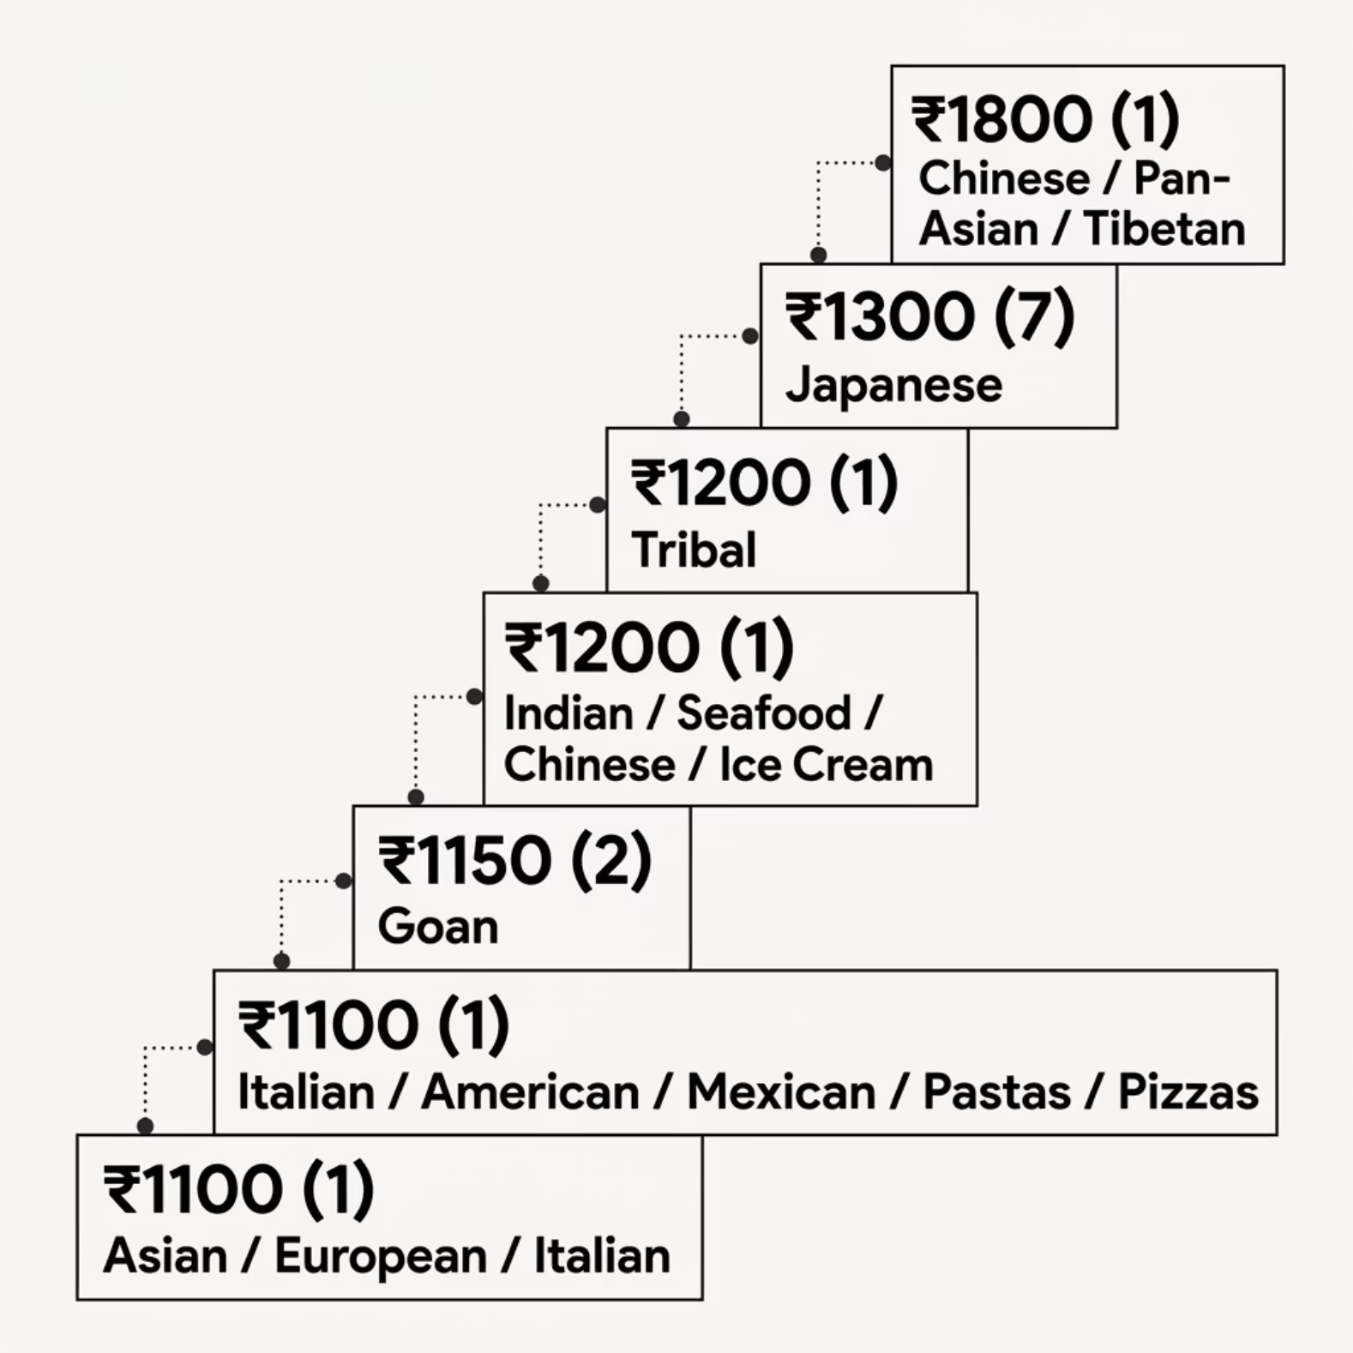

Cuisine & Pricing Intelligence
Premium Cuisine Trends
Chinese/Pan-Asian cuisine commands the highest average price at ₹1,800, though only 1 restaurant. Japanese cuisine offers the best scale at ₹1,300 avg with 17 restaurants.
Average price across all restaurants: ₹348.44. Premium cuisines represent a high-margin opportunity in well-rated areas like Ashok Nagar, Bangalore.

Slide 8

Power BI Dashboard: Key Metrics
8,680
9
Restaurants
Cities
Total in dataset
Across India
348
38.33
Avg Price (₹)
Top Popularity
Per two people
Highest score achieved
Dashboard filters include City, Price_Category (Budget / Mid Value / Costly), and Delivery_Status (Fast / Moderate / Slow) for interactive exploration.

Slide 9
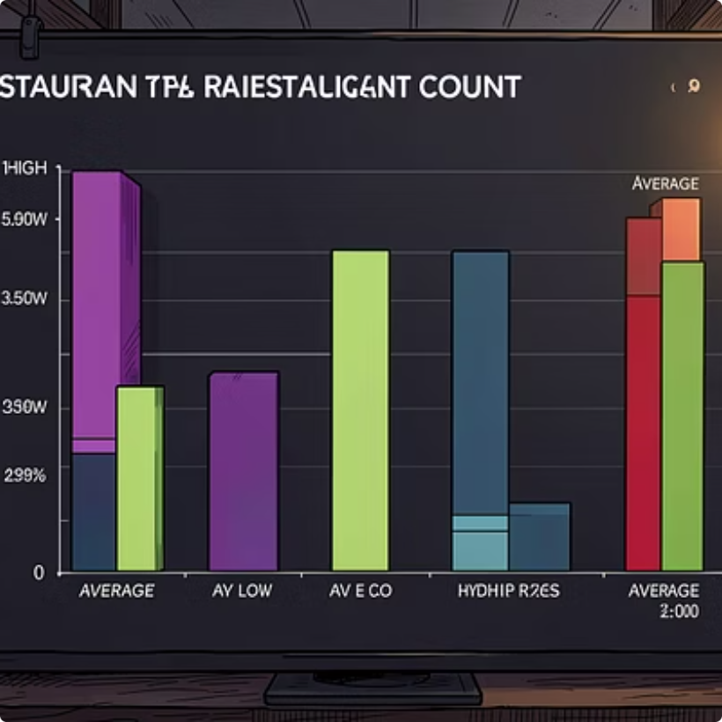
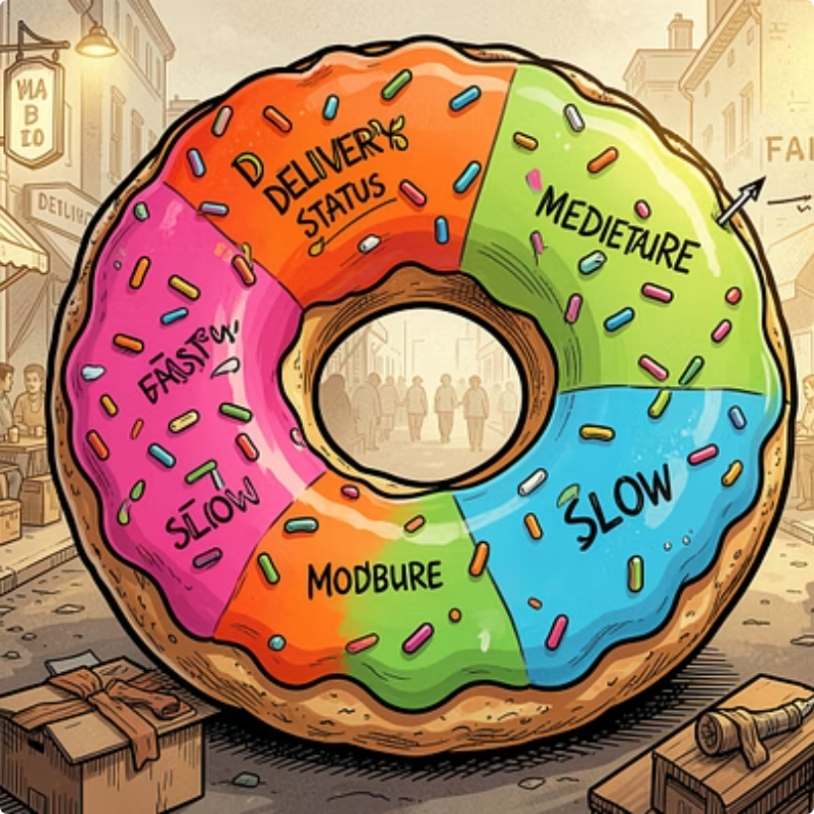
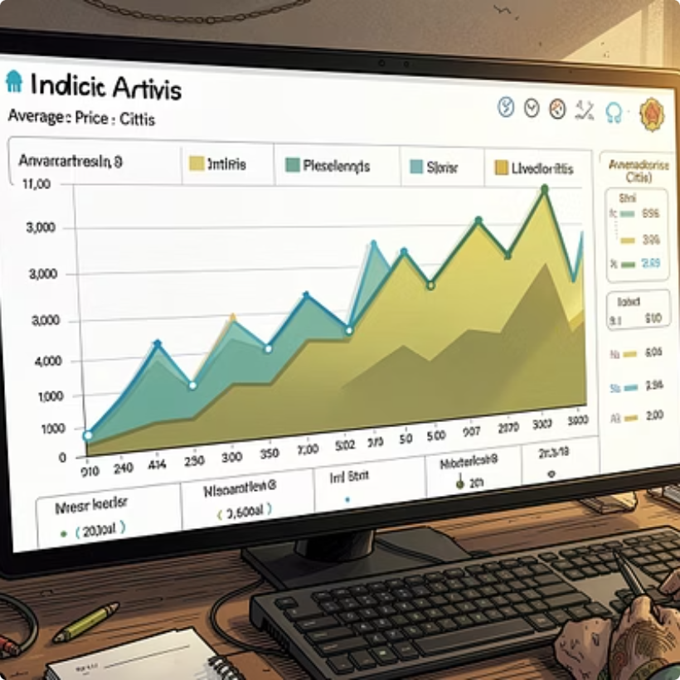

Power BI Visualizations
Dashboard pages cover: Basic Details (rating status, food types by city), Delivery Insights (delivery status by city, avg delivery time), and Price & Popularity (top restaurants by price, popularity distribution). Popularity breakdown: Average Popular 9.52%, More Popular 8.22%, Less Popular 0.83%.

Slide 10
Business Recommendations
Fix Slow Deliveries
Boost Hidden Gems
Help Costly Restaurants
Add more riders in high-delay areas: Ahmedabad, Kolkata, Chennai
Promote "At Risk" restaurants (high rating, few reviews) on the app homepage
Offer discounts or combos for 2,625 costly, low-popularity restaurants
Expand Premium Food
Improve Low-Rated Spots
Encourage Japanese/Pan-Asian cuisine in high-rated areas like Ashok Nagar
Provide training and quality checks to low-rated budget restaurants

